Slide 1
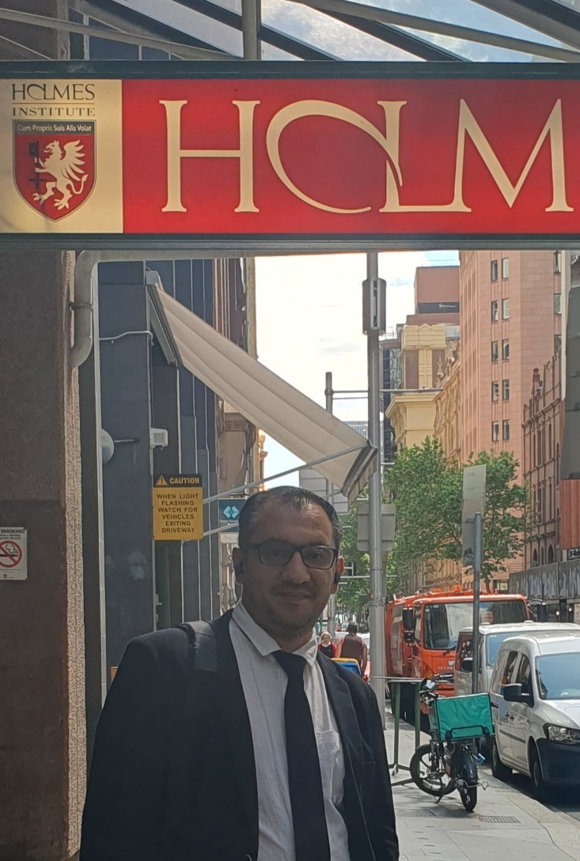

HS1021: Web Design
Student Success Guide and Weeks 2 – 3 Tutorial, Lab 1 Test & Online Test 1 Practice
Dr. Farshid Keivanian

Slide 2
Unit Overview
Web Design | Week 8–13 (Regular Term) / Intensive Mode Week 1–6 Lecturer: Dr. Farshid Keivanian Class Location: Lab Level 10 Thursdays: 3-5 PM Fridays: 3-5 PM (Only 15 May Friday and 29 May Friday starts at ~ 3:15 PM)

Slide 3
Unit Overview
Welcome to HS1021 Web Design.
This unit teaches you how websites work, how to design professional webpages, and how to create websites using HTML5 and CSS.
You will learn:
How the Internet and websites work
Website planning and structure
HTML5 webpage creation
CSS styling and layouts
Links, images, lists, and navigation

Slide 4
Unit Overview
This unit is very practical. Success comes from:
attending classes,
practising coding regularly,
completing weekly tutorials,
and building webpages every week.

Slide 5
Unit Overview
Responsive and user-friendly design
Hosting and domain management
Website accessibility and usability
SEO (Search Engine Optimization)
Teamwork and professional web development practices

Slide 6
Important Assessments
Assessment | Weight | Type
Lab Exercises | 20% | Individual
Online Test | 20% | Individual
Group Assignment | 60% | Group

Slide 7
Understanding the Lab Test (Important)
From the Blackboard screenshot:
Lab Test 1
Total Marks: 4
Time Limit: 30 minutes
Questions Displayed: 8 random questions
Question Types:
Multiple Choice
True/False
Completion
Critical Thinking
Essay Questions

Slide 8
Understanding the Lab Test (Important)
Due Date
Friday 15 May 2026 – 9:00 PM (AEST)
Important
Only 1 attempt
Automatic submission after 30 minutes
Questions are random
You must prepare weekly

Slide 9
Weekly Learning Plan
Week 1 – Internet and Web Basics
Learn:
Internet concepts
Web browsers
Servers and clients
HTTP, TCP/IP
IP addresses
LMS concepts
Web standards (W3C)
Practice:
Answer MCQ and True/False questions
Learn basic definitions

Slide 10
Weekly Learning Plan
Week 2 – Website Planning
Learn:
Website structure
Navigation design
Wireframes
White space
Accessibility
Practice:
Draw simple wireframes
Plan webpage layouts

Slide 11
Weekly Learning Plan
Week 3 – HTML5 Basics
Learn:
HTML structure
Headings
Paragraphs
Lists
Basic webpage template
Practice:
Build simple webpages daily

Slide 12
Weekly Learning Plan
Week 4 – Links and Images
Learn:
Hyperlinks
Navigation menus
Images
File paths
Practice:
Create multi-page websites

Slide 13
Weekly Learning Plan
Week 5 – Divs, Headings and Lists
Learn:
div containers
webpage organization
ordered and unordered lists
Practice:
Build cleaner webpage structures

Slide 14
Weekly Learning Plan
Week 6 – CSS Basics
Learn:
Colors
Fonts
Backgrounds
Borders
External CSS
Practice:
Style webpages professionally

Slide 15
How to Study Properly for This Unit
Step 1 – Attend Every Class
Web Design is skill-based.
Missing one class can make later topics difficult.
What to do
Attend both weekly sessions
Take notes
Ask questions
Watch demonstrations carefully

Slide 16
How to Study Properly for This Unit
Avoid
Skipping practical labs
Relying only on slides
Waiting until assessment week

Slide 17
How to Study Properly for This Unit
Step 2 – Practise Coding Every Week
Coding improves only with practice.
Minimum Recommendation
Practice:
30–60 minutes daily
Build small webpages weekly

Slide 18
How to Study Properly for This Unit
Good Habit
After each class:
Re-type the examples yourself
Change colors, text, images
Experiment with layouts

Slide 19
How to Study Properly for This Unit
Step 3 – Create a Practice Folder
Organize your work.
Example:
HS1021/ ├ Week 1 and 2/ ├ Week 3 and 4/ ├ Week 5 and 6/ ├ Images/ ├ CSS/ └─ Assignment/
This helps avoid confusion later.

Slide 20
How to Study Properly for This Unit
Step 4 – Learn by Building
Do not memorize only.
Build:
Personal webpage
Restaurant webpage
Portfolio webpage
E-commerce homepage
Small projects improve skills quickly.

Slide 21
How to Study Properly for This Unit
6. Lab Test Preparation Guide
The Lab Test uses questions from tutorials and lectures.
Best Preparation Method
1. Review Tutorial Questions Weekly
Especially:
Multiple choice
True/False
Definitions

Slide 22
How to Study Properly for This Unit
2. Memorize Important Terms
Examples:
Term | Meaning
Server | Computer storing websites
Client | User computer/browser
HTTP | Web communication protocol
TCP/IP | Internet communication rules
IP Address | Device network address
Wireframe | Website planning layout
Responsive Design | Works on all devices
W3C | Web standards organization

Slide 23
How to Study Properly for This Unit
3. Practice Essay Questions
Example:
Question
What is the difference between a text editor and an HTML editor?
Simple Answer
A text editor writes plain text only, while an HTML editor helps create webpages with HTML features such as syntax highlighting and webpage preview.

Slide 24
How to Study Properly for This Unit
4. Practice Time Management
The test is only 30 minutes.
Tips:
Answer easy questions first
Do not spend too long on one question
Leave essay questions for the end if needed

Slide 25
How to Study Properly for This Unit
7. Important Hints for Success
Hint 1 – Learn HTML Tags Properly
Important tags:
<html> <head> <body> <h1> <p> <img> <a> <div> <ul> <li>
Practice them often.

Slide 26
How to Study Properly for This Unit
Hint 2 – Understand, Don’t Memorize
Example:
Instead of memorizing:
“HTTP is a protocol.”
Understand:
HTTP allows browsers and servers to communicate.
Understanding helps in exams and assignments.

Slide 27
How to Study Properly for This Unit
Hint 3 – Use Simple and Clean Code
Good:
<h1>Welcome</h1> <p>This is my webpage.</p>
Avoid:
messy formatting
missing closing tags
random spacing

Slide 28
How to Study Properly for This Unit
Hint 4 – Validate Your HTML
Always test:
webpage layout
links
images
spelling
HTML syntax

Slide 29
How to Study Properly for This Unit
Hint 5 – Start Group Assignment Early
The group assignment is worth 60%.
Do not wait until the final weeks.

Slide 30
How to Study Properly for This Unit
8. Group Assignment Survival Guide
What You Must Do
Before Coding
Understand business scenario
Plan the website
Draw wireframes
Decide responsibilities

Slide 31
How to Study Properly for This Unit
Teamwork Tips
Divide tasks:
HTML pages
CSS styling
Images/content
Testing
Documentation

Slide 32
How to Study Properly for This Unit
Communication
Use:
WhatsApp
Teams
Google Drive
Meet weekly.

Slide 33
How to Study Properly for This Unit
Avoid These Problems
Do NOT:
copy websites
leave work until last week
depend on one team member
ignore W3C validation
submit unfinished pages

Slide 34
Common Mistakes Students Make
Mistake | Better Approach
Studying only before tests | Study weekly
Copying code without understanding | Type and practise yourself
Ignoring tutorials | Complete every tutorial
Poor file organization | Use folders properly
Not testing webpages | Test in browser often
Waiting too late for assignment | Start early

Slide 35
Example Study Routine
Each Week
Before Class
Read lecture slides
Watch short HTML/CSS videos
During Class
Take notes
Follow coding demonstrations
After Class
Rebuild examples
Complete tutorial questions
Practice coding
Weekend
Review all weekly topics
Build one small webpage

Slide 36
Important Lab Test Schedule
Lab Test Dates
Lab | Due Date | Open Time | Close Time | Duration
Lab 1 | 15 May 2026 | 6:00 AM | 9:00 PM | 30 mins
Lab 2 | 22 May 2026 | 6:00 AM | 9:00 PM | 30 mins
Lab 3 | 29 May 2026 | 6:00 AM | 9:00 PM | 30 mins
Lab 4 | 5 June 2026 | 6:00 AM | 9:00 PM | 30 mins
Lab 5 | 12 June 2026 | 6:00 AM | 9:00 PM | 30 mins

Slide 37
IMPORTANT NOTE
Test links are ONLY available during the scheduled time period.
If you miss the test time:
the link disappears,
and you may receive zero marks.
Always plan early.

Slide 38
VERY IMPORTANT LAB TEST INSTRUCTIONS
Internet Connection
You MUST:
use stable internet,
avoid weak Wi-Fi,
avoid mobile hotspots if unreliable.

Slide 39
VERY IMPORTANT LAB TEST INSTRUCTIONS
Important
Special consideration is NOT granted for:
poor internet,
disconnections,
unstable Wi-Fi.
If needed:
use university labs,
public libraries,
or another reliable location.

Slide 40
Device Requirements
You MUST use:
a reliable laptop or desktop computer.
You CANNOT use:
phones,
tablets,
Blackboard mobile app.

Slide 41
Browser Requirements
Recommended Browsers
Use:
Google Chrome
Mozilla Firefox
Do NOT use:
Safari
Microsoft Edge
Blackboard app

Slide 42
Before Starting the Test
Step-by-Step Preparation
1. Update Your Device Early
Install:
browser updates,
Windows updates,
software updates BEFORE test day.
Important
If your computer updates during the test:
no special consideration is given.

Slide 43
Before Starting the Test
2. Close Extra Programs
Close:
games,
streaming apps,
unnecessary browser tabs,
downloads.
This improves performance.

Slide 44
Before Starting the Test
3. Charge Your Laptop
Always:
fully charge your laptop,
or keep charger connected.

Slide 45
Before Starting the Test
4. Use Only ONE Device
You must:
use one computer only,
one browser only,
one Blackboard tab only.

Slide 46
Before Starting the Test
Avoid
Do NOT:
open Blackboard in multiple tabs,
switch devices,
login from phone and laptop together.
This may break the test.

Slide 47
Before Starting the Test
9. During the Test
Once You Click “Begin”
You have:
ONLY 30 minutes
The timer:
DOES NOT stop,
even if you leave the test.

Slide 48
How to Answer Questions Properly
VERY IMPORTANT
After answering each question:
Click “CONTINUE”
Do NOT click SUBMIT early.

Slide 49
How to Answer Questions Properly
You Cannot Go Back
Once you move forward:
you cannot change answers.
So:
read carefully,
double-check before continuing.

Slide 50
Final Submission
After answering ALL questions:
Click “SUBMIT”
Only submit when fully finished.

Slide 51
Automatic Submission
If time finishes:
Blackboard automatically saves and submits your work.

Slide 52
What Is NOT Allowed
Students MUST NOT:
Use:
VPNs
overseas IP addresses
Penalties apply.
Use:
mobile phones
tablets

Slide 53
What Is NOT Allowed
Open:
multiple browsers
multiple tabs
multiple devices
Restart the Test
Once submitted:
you cannot restart.

Slide 54
If Technical Errors Happen
Do This Immediately
Step 1
Take a screenshot of the error.
Step 2
Email Blackboard Helpdesk DURING the test availability time.
Email Must Include:
student number
unit code
in the subject line.

Slide 55
If Technical Errors Happen
Important
Do NOT contact:
Student Services
Lecturer
for technical support.
Only Blackboard Helpdesk handles technical issues.

Slide 56
Important HTML Tags
Tag | Purpose
<html> | Root webpage
<head> | Metadata
<title> | Browser title
<body> | Visible content
<h1> | Heading
<p> | Paragraph
<a> | Link
<img> | Image
<div> | Container

Slide 57
Important Topics from Lab Tests
Students should study:
Internet Basics
Important Concepts
Topic | Meaning
Server | Stores websites
Client | User computer
HTTP | Web communication
TCP/IP | Internet communication
IP Address | Device network address
Protocol | Communication rules

Slide 58
Website Planning
Students must understand:
wireframes,
white space,
responsive design,
accessibility,
webpage structures.

Slide 59
Example Questions
What is responsive design?
A design that works properly across different devices.
What is a wireframe?
A planning layout showing webpage structure.

Slide 60
HTML Questions
Students must know:
Correct HTML Structure
<!DOCTYPE html> <html> <head> <title>Page</title> </head> <body> Content </body> </html>

Slide 61
Common Lab Test Questions
Question Topic | Correct Idea
Root element | <html>
Paragraph tag | <p>
Visible webpage section | <body>
Metadata section | <head>
HTML comments | <!-- comment -->
First HTML declaration | <!DOCTYPE html>

Slide 62
Publishing and Hosting Concepts
Students must understand:
Topic | Meaning
Publishing | Uploading webpages to server
Hosting | Storing website online
Domain Name | Website address
Web Server | Computer serving websites

Slide 63
Publishing and Hosting Concepts
Example
Publishing means:
Transferring webpages from your computer to a web server.

Slide 64
Study Strategy for Lab Tests
Best Method
Before Each Test:
Review lecture slides
Complete tutorial questions
Practise HTML coding
Review definitions
Practise multiple-choice questions

Slide 65
Time Management During Tests
Recommended Strategy
Task | Time
Easy MCQs | 10 mins
Medium questions | 10 mins
Difficult questions | 5 mins
Final review | 5 mins

Slide 66
Common Mistakes to Avoid
Avoid These Problems
Do NOT:
study only one day before,
memorize without understanding,
skip tutorials,
leave assignments late,
ignore HTML practice,
use mobile devices for tests,
use weak internet.

Slide 67
Group Assignment Advice
The group assignment is worth:
60%
Start early.

Slide 68
Good Team Practices
Divide Tasks
Example:
Student | Responsibility
Student 1 | HTML
Student 2 | CSS
Student 3 | Images
Student 4 | Testing

Slide 69
Web Design Best Practices
Students should:
keep layouts simple,
use readable fonts,
maintain clean navigation,
use proper spacing,
test websites in multiple browsers.

Slide 70
Accessibility Tips
Good websites should:
work for all users,
include readable text,
use proper contrast,
support different devices.

Slide 71
Recommended Software
Best Code Editors
Visual Studio Code
Notepad++
Browsers
Use:
Chrome
Firefox

Slide 72
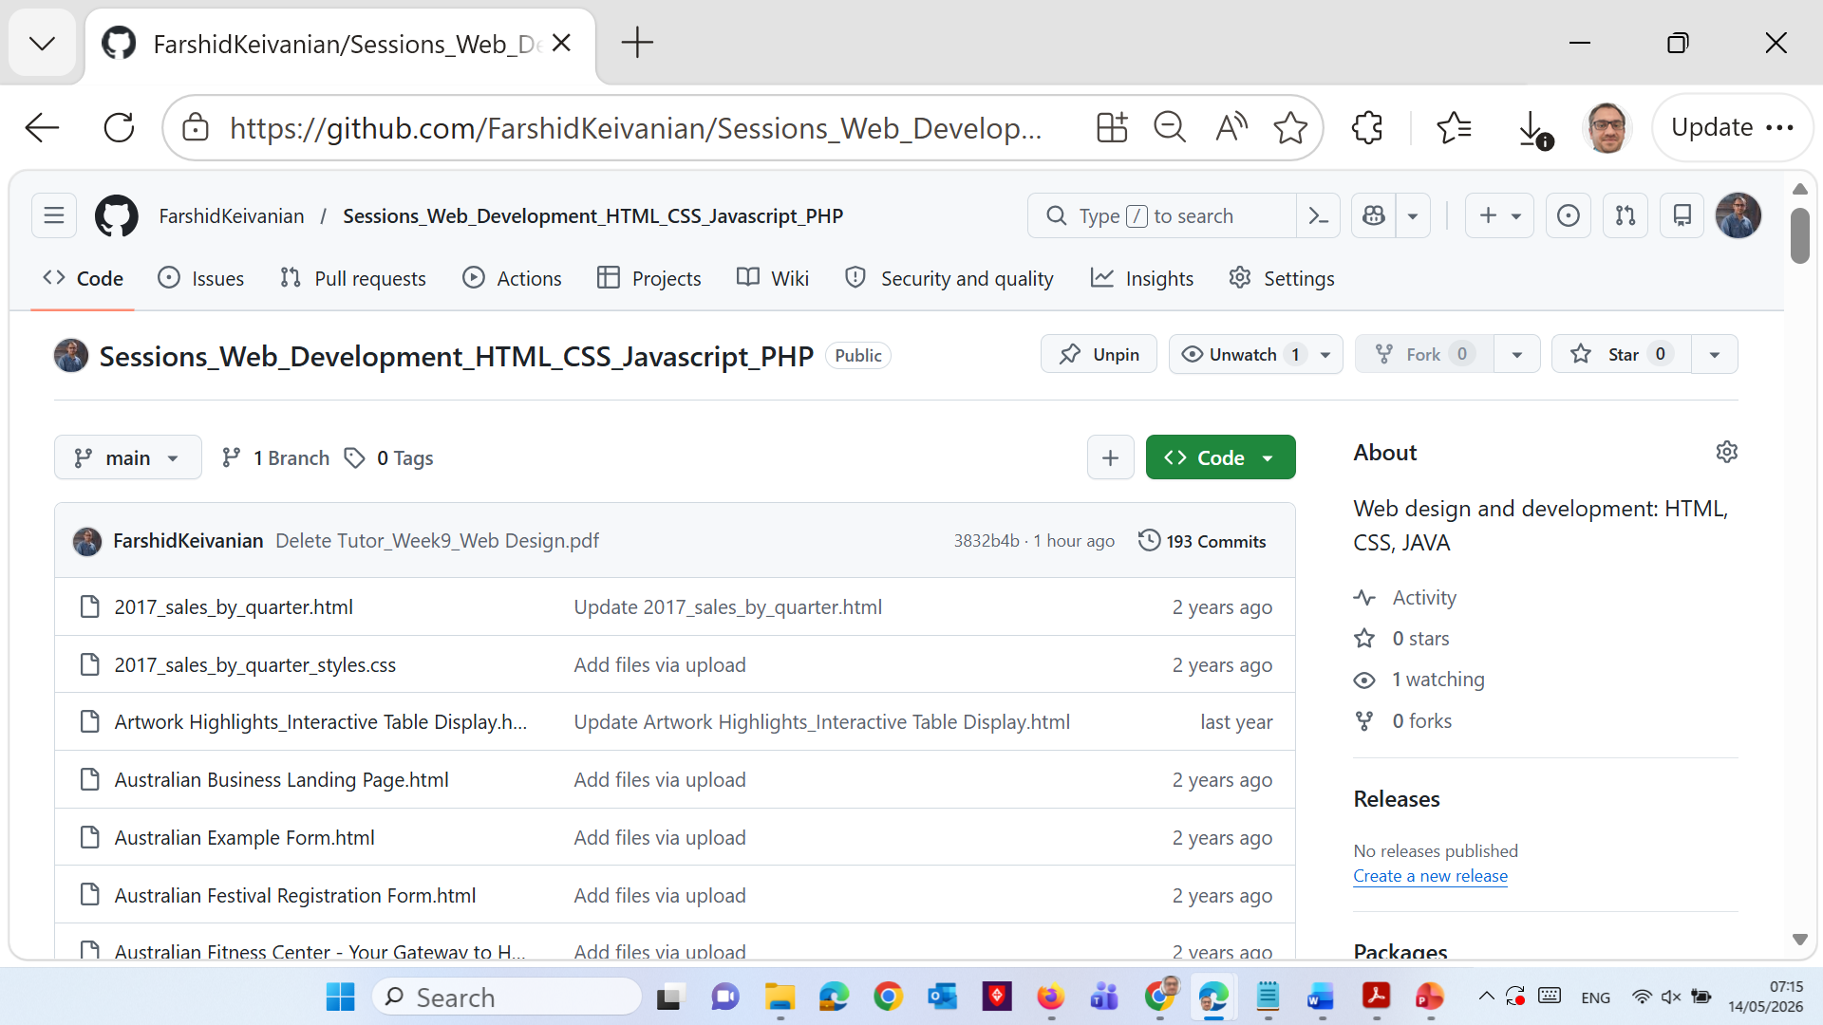
Recommended Software
Helpful Websites
GitHub Farshid Keivanian FarshidKeivanian/Sessions_Web_Development_HTML_CSS_Javascript_PHP: Web design and development: HTML, CSS, JAVA
W3Schools
MDN Web Docs
W3C Validator

Slide 73
Final Success Advice
Students who succeed usually:
attend every class,
practise weekly,
complete tutorials,
start assessments early,
ask questions,
and build webpages regularly.

Slide 74
Final Message
HS1021 is not difficult if students:
stay consistent,
practise every week,
and manage their time properly.
The key to success is:
Practice + Preparation + Consistency.

Slide 75
Weeks 2 – 3 Tutorial
Now let’s practice Weeks 2 – 3 Tutorials to support your learning. Please complete portfolio.docx – Personal Portfolio Website Planning Document

Slide 76
Weeks 2 – 3 Tutorial
Now complete portfolio.docx – Personal Portfolio Website Planning Document
Topic | Web Developer Questions | Answers
Purpose of the Website | What is the purpose and goal of the website? | The purpose of the website is to create a professional online portfolio to showcase web design and development skills, projects, education, and achievements. The goal is to help future employers and clients learn more about the developer and view completed work.

Slide 77
Weeks 2 – 3 Tutorial
Now complete portfolio.docx – Personal Portfolio Website Planning Document
Topic | Web Developer Questions | Answers
Purpose of the Website | What is the company’s mission statement? | To create modern, user-friendly, accessible, and responsive websites that solve business problems and provide excellent user experiences.

Slide 78
Weeks 2 – 3 Tutorial
Now complete portfolio.docx – Personal Portfolio Website Planning Document
Topic | Web Developer Questions | Answers
Target Audience | Describe the target audience (age, gender, demographics) | The target audience includes employers, clients, businesses, university staff, and technology professionals between 18–50 years old who are interested in web development services and projects.

Slide 79
Weeks 2 – 3 Tutorial
Now complete portfolio.docx – Personal Portfolio Website Planning Document
Topic | Web Developer Questions | Answers
Target Audience | What information is most pertinent to the users? | Users want to see portfolio projects, technical skills, education, contact information, work experience, and examples of previous website designs.

Slide 80
Weeks 2 – 3 Tutorial
Now complete portfolio.docx – Personal Portfolio Website Planning Document
Topic | Web Developer Questions | Answers
Multiplatform Display | Will you design for multiple platform display or only focus on a desktop or mobile design? | The website will be designed for multiple platforms including desktop, tablet, and mobile devices using responsive web design techniques.
Wireframe | How many pages will be included in the website? | The website will include 5 pages: Home, About Me, Portfolio, Skills, and Contact.

Slide 81
Weeks 2 – 3 Tutorial
Now complete portfolio.docx – Personal Portfolio Website Planning Document
Topic | Web Developer Questions | Answers
Wireframe | How will the pages be organized? | The pages will be organized using a navigation menu located at the top of every webpage.

Slide 82
Weeks 2 – 3 Tutorial
Now complete portfolio.docx – Personal Portfolio Website Planning Document
Topic | Web Developer Questions | Answers
Wireframe | What type of website structure is appropriate for the content? | A hierarchical website structure is most appropriate because users can easily navigate between sections and pages.

Slide 83
Weeks 2 – 3 Tutorial
Now complete portfolio.docx – Personal Portfolio Website Planning Document
Topic | Web Developer Questions | Answers
Graphics | What graphics will you use on the website? | The website will use professional images, project screenshots, icons, logos, and simple banners related to web design and technology.

Slide 84
Weeks 2 – 3 Tutorial
Now complete portfolio.docx – Personal Portfolio Website Planning Document
Topic | Web Developer Questions | Answers
Color | What colors will you use within the site to enhance the purpose and brand? | Blue, white, dark gray, and light gray colors will be used to create a modern and professional appearance.

Slide 85
Weeks 2 – 3 Tutorial
Now complete portfolio.docx – Personal Portfolio Website Planning Document
Topic | Web Developer Questions | Answers
Typography | What font styles will you use within the website? | Modern and easy-to-read fonts such as Arial, Verdana, and Sans-serif will be used throughout the website.

Slide 86
Weeks 2 – 3 Tutorial
Now complete portfolio.docx – Personal Portfolio Website Planning Document
Topic | Web Developer Questions | Answers
Accessibility | How will the website accommodate people with disabilities? | The website will include readable fonts, high color contrast, alternative text for images, keyboard-friendly navigation, and responsive layouts for accessibility.

Slide 87
Weeks 2 – 3 Tutorial
Part 2 – What do you want this website to accomplish?
This website should help showcase professional web development skills and create opportunities for employment, freelance work, networking, and career growth. It should present projects and technical abilities in a professional and easy-to-use format.

Slide 88
Weeks 2 – 3 Tutorial
2. webpublishing.docx – Web Publishing Information
Information Needed to Publish Files to a Free Web Server
Item | Information
Provider name | InfinityFree
Your name | [Student Name]
Username | studentweb1021
Password | WebDesign2026!
What process is required to request a free web server space? | Go to https://infinityfree.net/ and create a free account using an email address. Verify the email, create a hosting account, and activate the free web hosting service.

Slide 89
Weeks 2 – 3 Tutorial
2. webpublishing.docx – Web Publishing Information
Information Needed to Publish Files to a Free Web Server
What software is used to publish webpages to the web server? | FileZilla Client is commonly used to upload webpage files to the web server using FTP.
What special software settings are required? | Host: ftpupload.net Username: provided by hosting company Password: account password Port: 21
Root web folder | htdocs/
Root URL | http://studentweb1021.infinityfreeapp.com/

Slide 90
Weeks 2 – 3 Tutorial
2. webpublishing.docx – Web Publishing Information
Information Needed to Publish Files to a Free Web Server
What URL is created by the server? | Files uploaded to htdocs/index.html become available at: http://studentweb1021.infinityfreeapp.com/index.html
How do I contact my free web server Help Desk if needed? | Support forums and help pages are available at https://forum.infinityfree.com/
Where can I get additional help on how to publish my webpages? | YouTube tutorials, FileZilla tutorials, and hosting provider documentation can be used for additional support.

Slide 91
Weeks 2 – 3 Tutorial
Three Ways Free Web Hosting Companies Generate Revenue
Advertisements placed on free websites
Selling premium hosting plans and upgrades
Selling domain names and additional services

Slide 92
Weeks 2 – 3 Tutorial
3. webserveralternatives.docx – Web Hosting Alternatives
Web Hosting Alternatives Comparison
 | Alternative 1 | Alternative 2 | Alternative 3
Websites | Hostinger.com | GoDaddy.com | HostGator.com
Cost for most basic plan | $2.99/month | $4.99/month | $3.75/month
Contract length | 1 year | 1 year | 3 years
Disk space | 50 GB | 100 GB | Unlimited
Domain name | Included | Included | Included

Slide 93
Weeks 2 – 3 Tutorial
3. webserveralternatives.docx – Web Hosting Alternatives
Web Hosting Alternatives Comparison
 | Alternative 1 | Alternative 2 | Alternative 3
Traffic | Unlimited | Unlimited | Unlimited
Pros | Affordable, beginner friendly, fast performance | Strong customer support, popular provider | Unlimited bandwidth and storage
Cons | Higher renewal prices | More expensive after first year | Some features require higher plans
Email | 1 free email account | Professional email available | Unlimited email accounts

Slide 94
Weeks 2 – 3 Tutorial
3. webserveralternatives.docx – Web Hosting Alternatives
Web Hosting Alternatives Comparison
Three Ways Free Hosting Companies Generate Revenue
Method | Explanation
Advertisements | Ads are displayed on users’ free websites
Premium Upgrades | Users pay to upgrade storage, speed, and features
Domain & Extra Services | Companies sell domain names, SSL certificates, and business tools

Slide 95
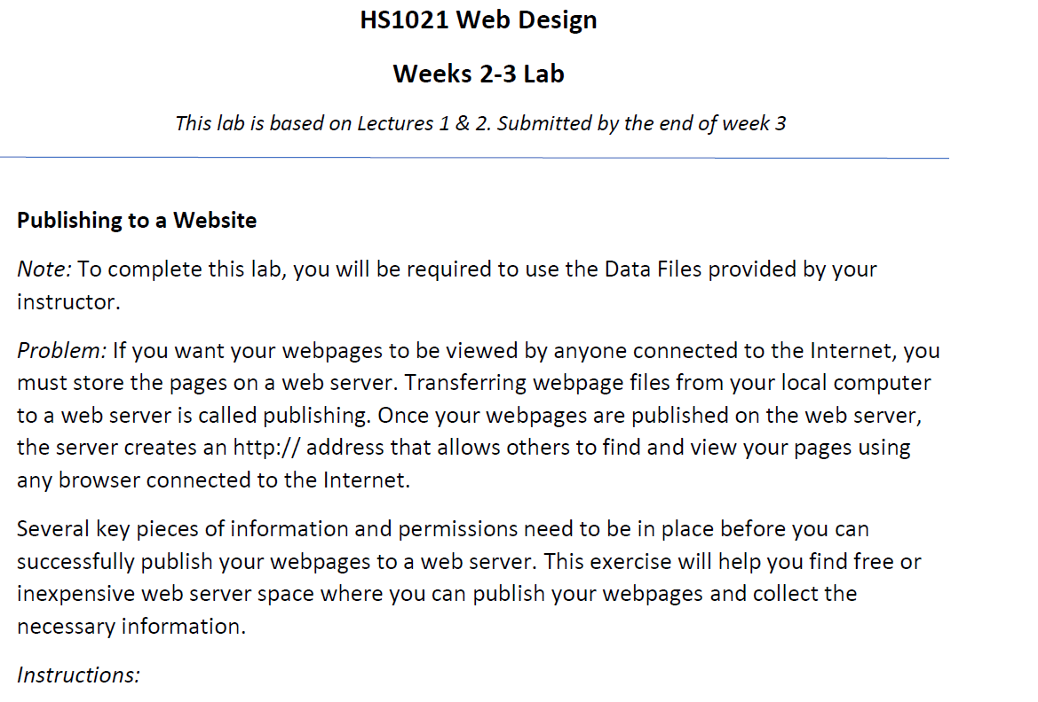
Weeks 2 – 3 Tutorial

Slide 96
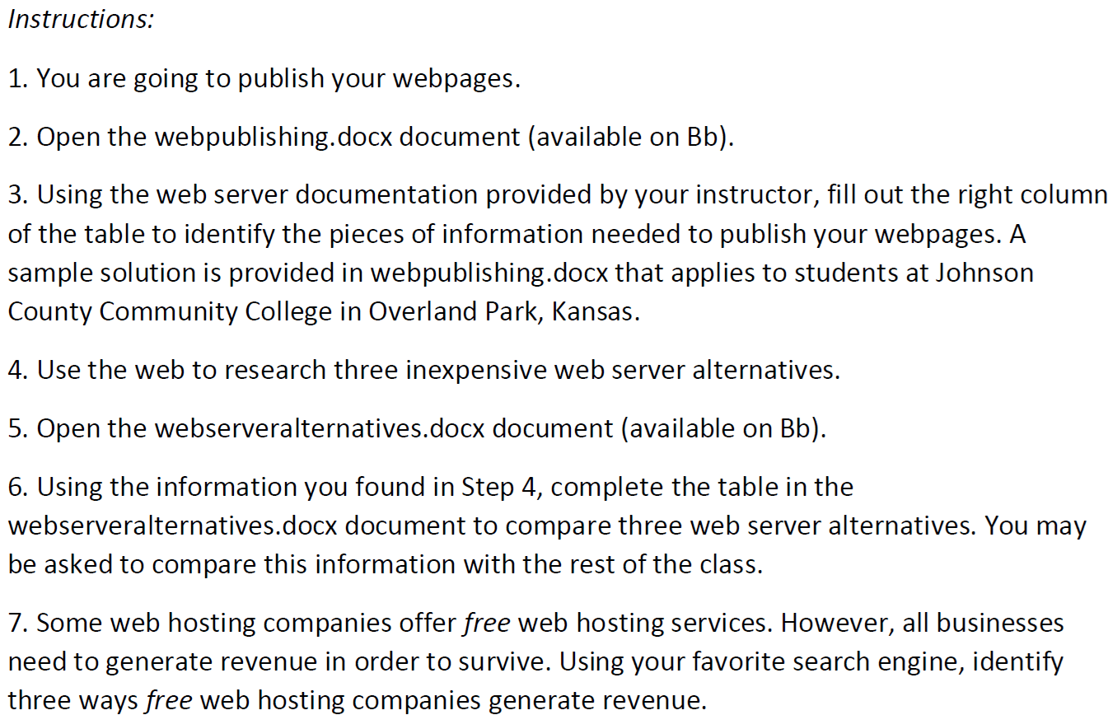

Slide 97
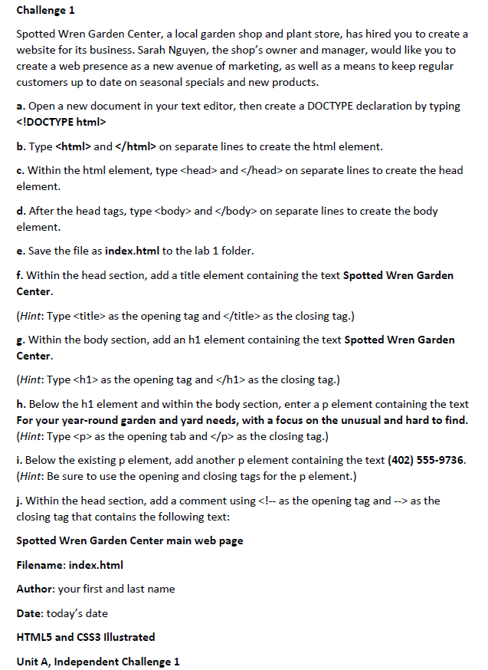

Slide 98
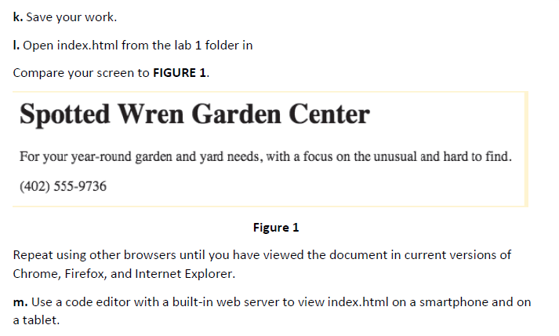

Slide 99
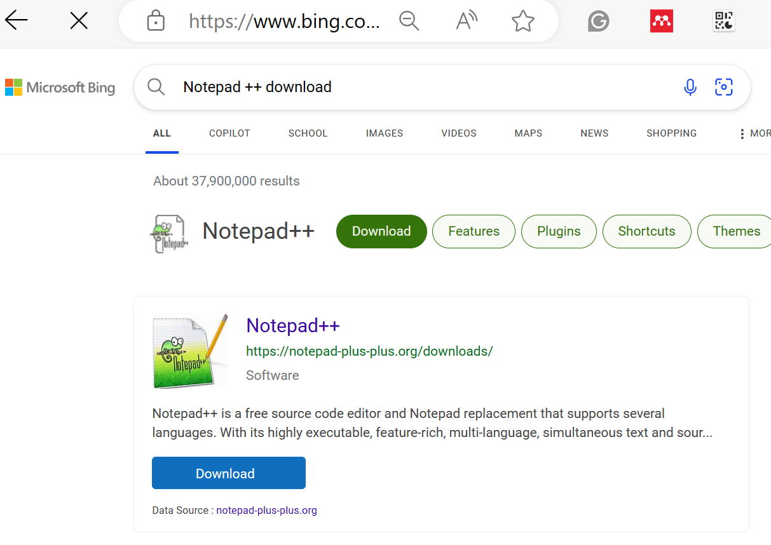
Weeks 2 – 3 Tutorial

Slide 100
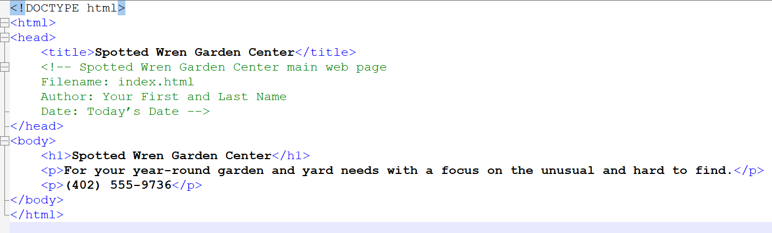
Challenge 1 (HTML code in Notepad ++)
Replace "Your First and Last Name" with your actual name and "Today’s Date" with the current date.
Save the file as ‘index.html’ in your desired folder (e.g., a folder named lab 1 or Week2)
Open ‘index.html’ in various web browsers (Chrome, Firefox, Internet Explorer) to view the webpage. Ensure it matches the expected layout and content.
Test viewing the webpage on different devices (smartphone, tablet) as suggested, using a code editor with a built-in web server or by manually transferring the file to the device for local viewing.

Slide 101
Challenge 1 (HTML code in Visual Studio)
<!DOCTYPE html>
<html>
<head>
<title>Spotted Wren Garden Center</title>
<!-- Spotted Wren Garden Center main web page
Filename: index.html
Author: Your First and Last Name
Date: Today’s Date -->
</head>
<body>
<h1>Spotted Wren Garden Center</h1>
<p>For your year-round garden and yard needs with a focus on the unusual and hard to find.</p>
<p>(402) 555-9736</p>
</body>
</html>

Slide 102
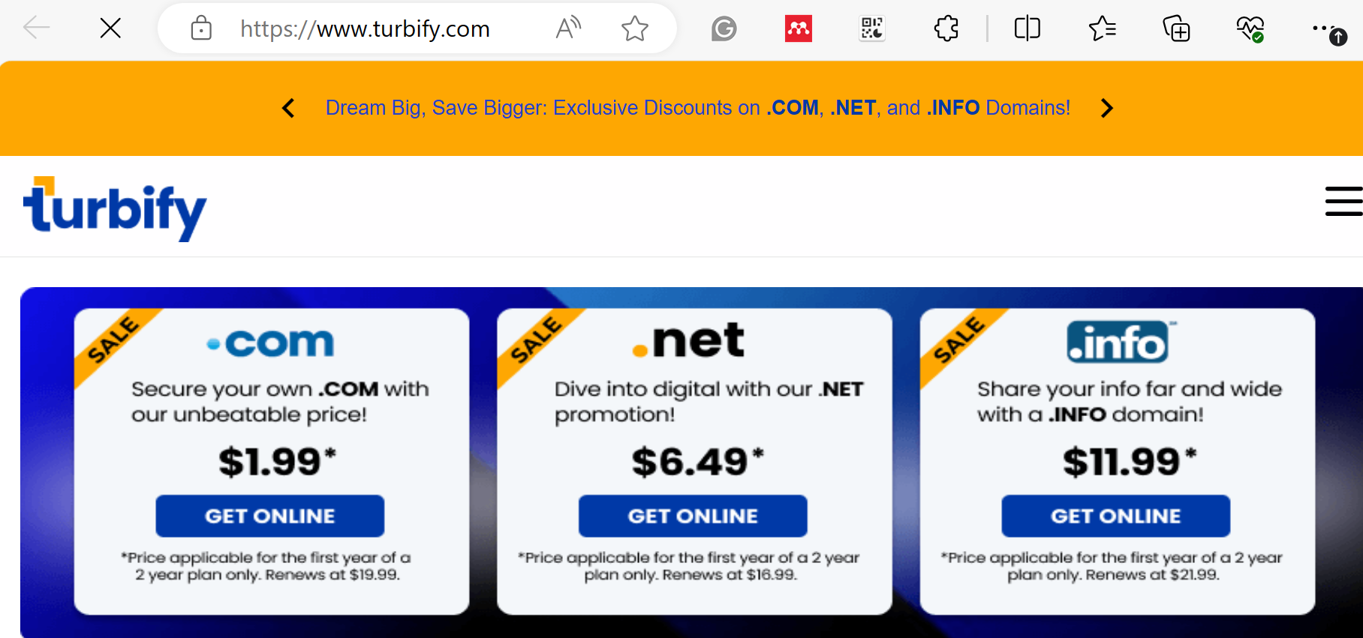
* Additional Information: Find Hosting Service e.g. https://www.turbify.com/

Slide 103
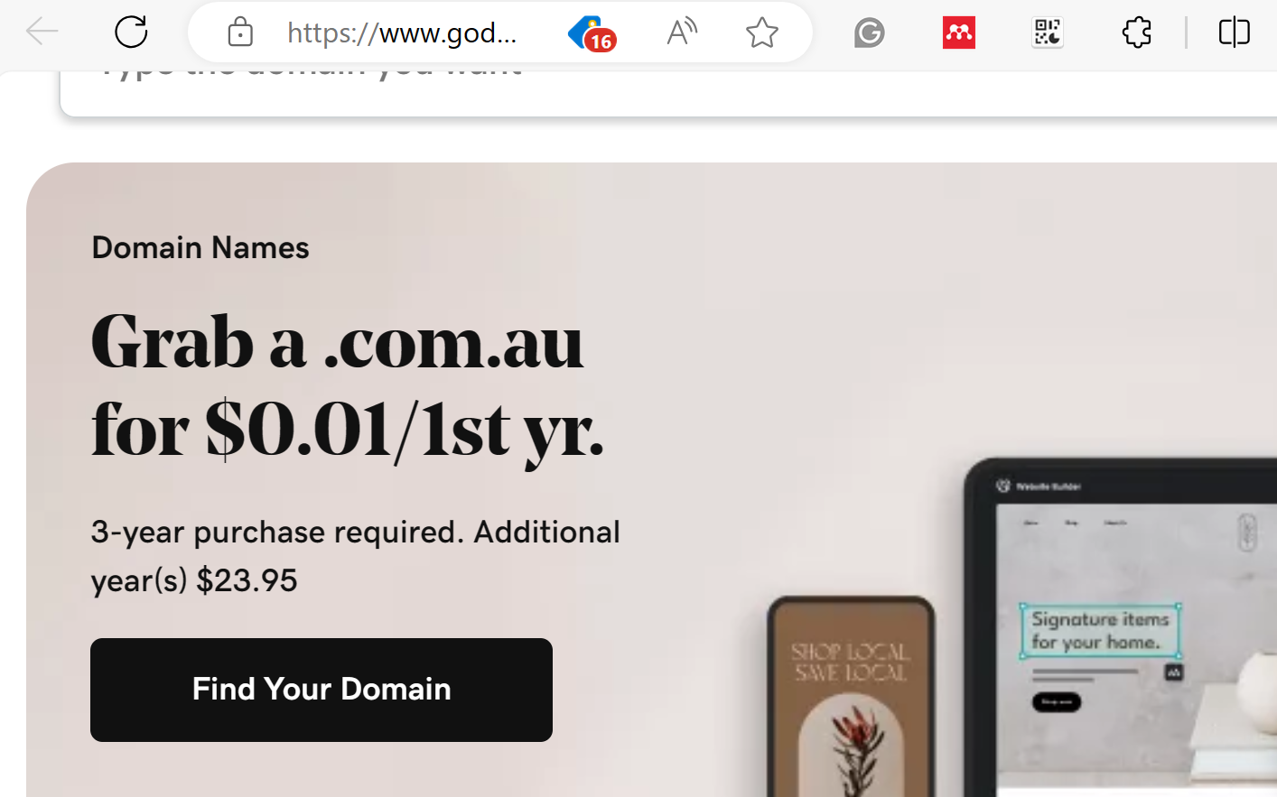
* Additional Information: Find Hosting Service e.g. https://www.godaddy.com/en-au

Slide 104
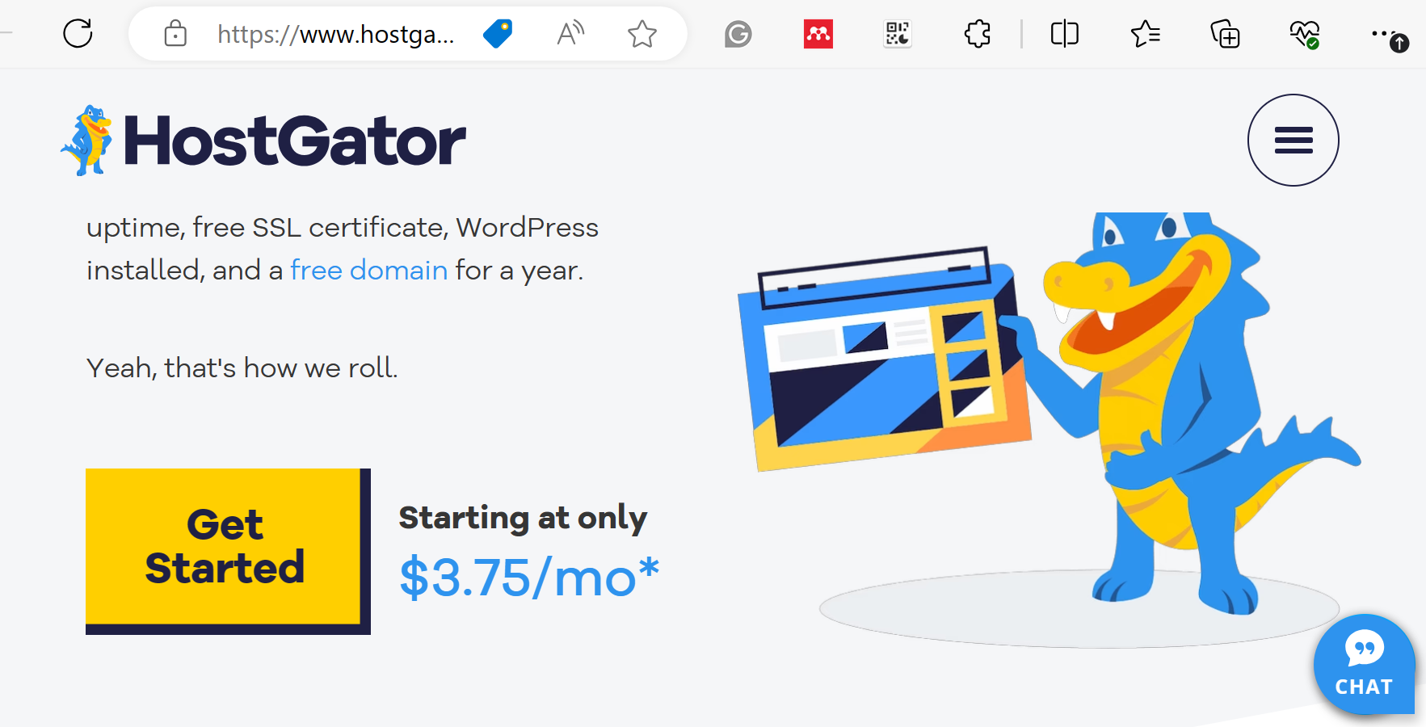
* Additional Information: Find Hosting Service e.g. https://www.hostgator.com/

Slide 105
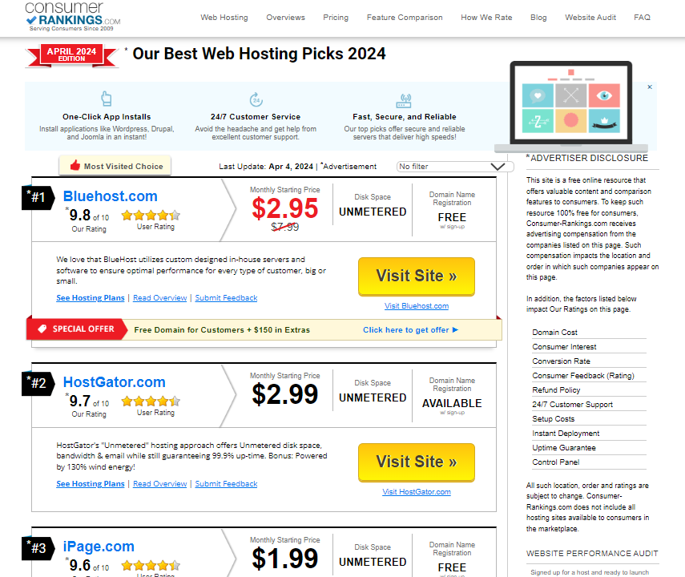
* Additional Information: Ranking Hosts, e.g. https://www.consumer-rankings.com/hosting/?a=148&c=2968&s1=76537702.78231060&vn=nrd3-nbf&ls=g&gclid=CM-8u8fezcECFZeFaQodw3YANA

Slide 106
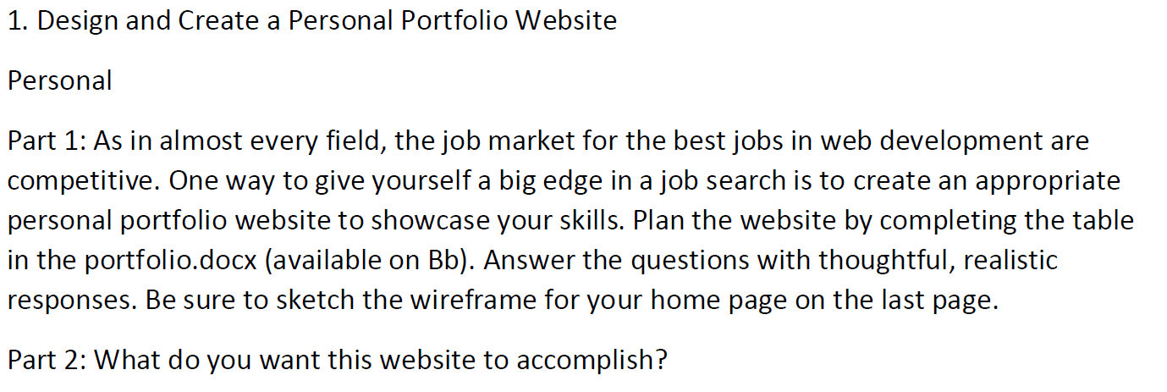
Challenge 2 (Homepage Portfolio Development)

Slide 107
Challenge 2 (Homepage Portfolio Development)
A cohesive practical example for the planning document of a personal portfolio website. This example is for a hypothetical website aimed at showcasing a web developer's professional portfolio.
Web Developer Questions | Practical Example Answers
Purpose of the Website | What is the purpose and goal of the website? | To showcase my web development projects, skills, and professional experience to potential employers and clients.
 | What is the company’s mission statement? | To demonstrate innovative web solutions and technical expertise that drive success for clients and businesses.
Target Audience | Describe the target audience (age, gender, demographics) | Tech industry professionals, hiring managers, and peers in web development, aged 20-50, regardless of gender.
 | What information is most pertinent to the users? | Portfolio of projects, list of skills, professional bio, and contact information.

Slide 108
Challenge 2 (Homepage Portfolio Development)
Multiplatform Display | Will you design for multiple platform display or only focus on a desktop or mobile design? | The site will be responsive, designed for optimal viewing across desktop, mobile, and tablet devices.
Wireframe | How many pages will be included in the website? | 5 main pages: Home, About, Portfolio, Skills, Contact.
 | How will the pages be organized? | A navigation bar at the top for easy access to all sections, with smooth scroll functionality for single-page navigation.
 | What type of website structure is appropriate for the content? | A single-page application (SPA) structure for the main content with additional pages for detailed project views.

Slide 109
Challenge 2 (Homepage Portfolio Development)
Graphics | What graphics will you use on the website? | High-quality images of my projects, personal branding logo, and icons for technical skills.
Color | What colors will you use within the site to enhance the purpose and brand? | A color scheme of navy blue (professionalism), light gray (modern), and white (clean).
Typography | What font styles will you use within the website? | "Roboto" for headings for its modern look and "Open Sans" for body text for readability.
Accessibility | How will the website accommodate people with disabilities? | Use of ARIA roles, ensuring keyboard navigability, high-contrast color scheme for the visually impaired, and alt text for all images.

Slide 110
Challenge 2 (homepage Portfolio Development)
The primary goal of this website is to effectively present my professional profile, including work portfolio, skills, and experience, to potential employers and clients in the web development field. This online presence will not only showcase my technical capabilities but also my design sensibility and attention to detail. Additionally, the website aims to facilitate easy communication through a contact form, encouraging professional connections and opportunities.

Slide 111
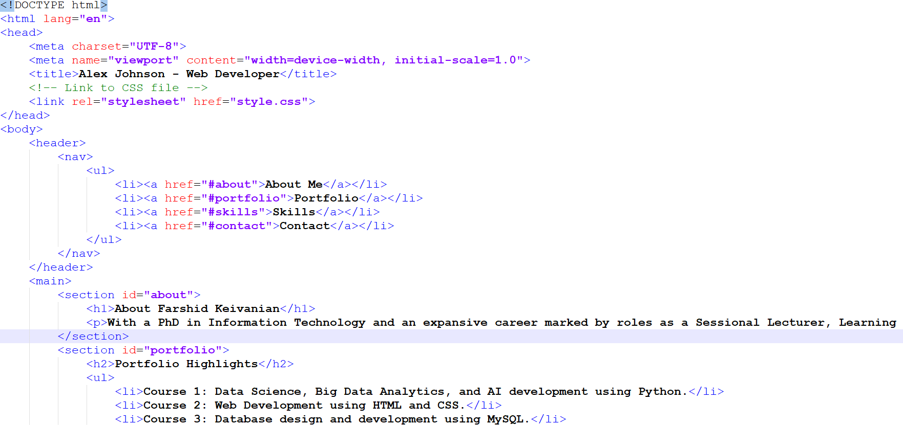
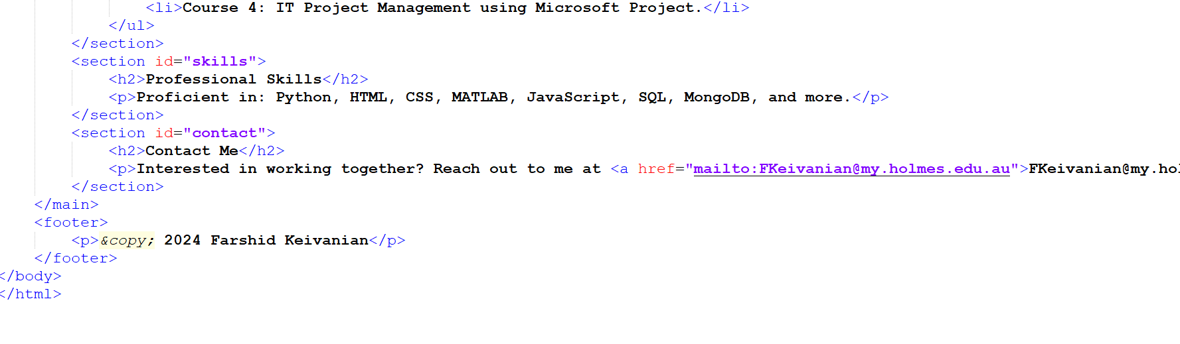

Slide 113
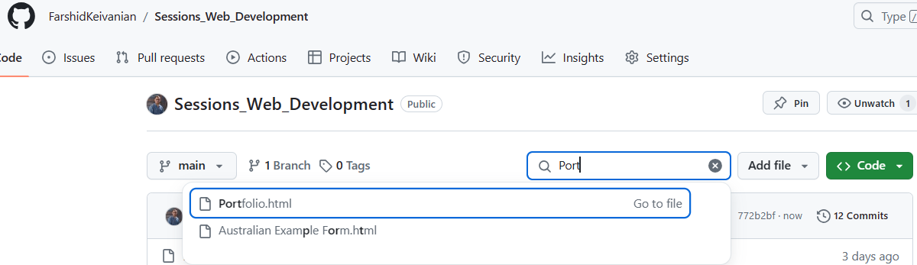
<!DOCTYPE html>
<html lang="en">
<head>
<meta charset="UTF-8">
<meta name="viewport" content="width=device-width, initial-scale=1.0">
<title>Alex Johnson - Web Developer</title>
<!-- Link to CSS file -->
<link rel="stylesheet" href="style.css">
</head>
<body>
<header>
<nav>
<ul>
<li><a href="#about">About Me</a></li>
<li><a href="#portfolio">Portfolio</a></li>
<li><a href="#skills">Skills</a></li>
<li><a href="#contact">Contact</a></li>
</ul>
</nav>
</header>
<main>
<section id="about">
<h1>About Farshid Keivanian</h1>
<p>With a PhD in Information Technology and an expansive career marked by roles as a Sessional Lecturer, Learning Facilitator, Researcher, and Global Advisor, I bring a wealth of experience that aligns with the responsibilities and aspirations of this role.</p>
</section>
<section id="portfolio">
<h2>Portfolio Highlights</h2>
<ul>
<li>Course 1: Data Science, Big Data Analytics, and AI development using Python.</li>
<li>Course 2: Web Development using HTML and CSS.</li>
<li>Course 3: Database design and development using MySQL.</li>
<li>Course 4: IT Project Management using Microsoft Project.</li>
</ul>
</section>
<section id="skills">
<h2>Professional Skills</h2>
<p>Proficient in: Python, HTML, CSS, MATLAB, JavaScript, SQL, MongoDB, and more.</p>
</section>
<section id="contact">
<h2>Contact Me</h2>
<p>Interested in working together? Reach out to me at <a href="mailto:FKeivanian@my.holmes.edu.au">FKeivanian@my.holmes.edu.au</a>.</p>
</section>
</main>
<footer>
<p>&copy; 2024 Farshid Keivanian</p>
</footer>
</body>
</html>
Modify the code based on your information or preferences and save as ‘Portfolio.html’

Slide 114
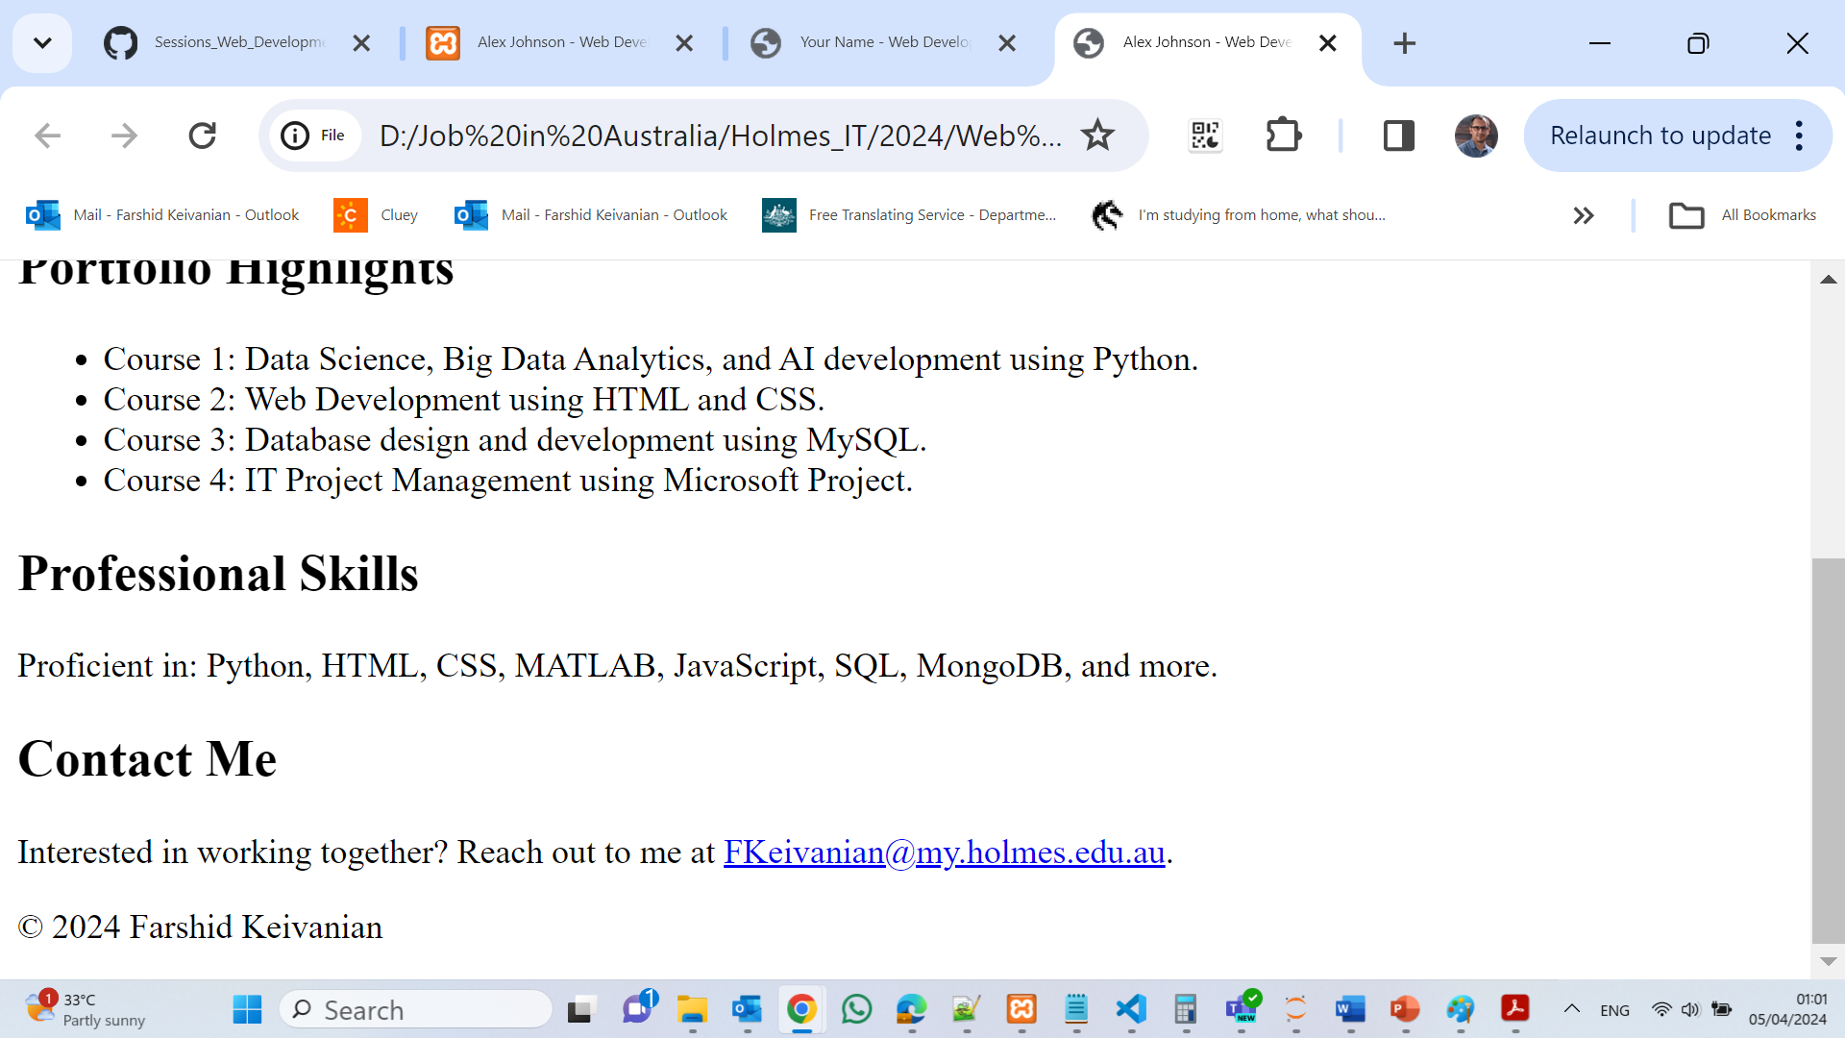

Slide 115
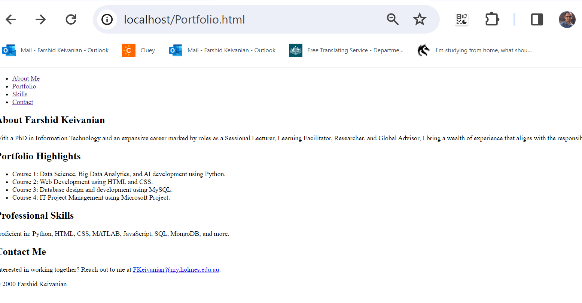
Using Xampp local host:

Slide 116
Lab 1 Test (Week 2 & 3) & Online Test 1 Practice
Topics Covered
Introduction to HTML
Website Planning and Design
Project Plans and Timelines
Target Audience Analysis
Webpage Structure

Slide 117
Lab 1 Test (Week 2 & 3) & Online Test 1 Practice
HTML Elements and Relationships
Web Servers and Publishing
Website Testing
White Space and Layout Design
Basic Web Development Concepts

Slide 118
Lab 1 Test (Week 2 & 3) & Online Test 1 Practice
Practice Includes
Multiple Choice Questions
Critical Thinking Questions
Case Studies
HTML Structure Concepts
Website Design Fundamentals

Slide 119
Lab 1 Test (Week 2 & 3) & Online Test 1 Practice
Goal
To prepare for:
Lab 1 Test (Week 2 & 3)
Online Test 1

Slide 120
Lab 1 Test (Week 2 & 3) & Online Test 1 Practice
Question 1
What is the process of transferring webpages from your computer to a web server called?
A. Publishing B. Deploying C. Hosting D. Streaming
Publishing means uploading or transferring your website files from your computer to a web server so people can access the website online.

Slide 121
Lab 1 Test (Week 2 & 3) & Online Test 1 Practice
Question 3
What must be filled in using information from the instructor’s web server documentation?
A. The HTML head section B. The browser compatibility list C. The domain purchase form
D. The right column of the publishing table
Students use the instructor’s web server details to complete the right column of the publishing table with the correct information.

Slide 122
Lab 1 Test (Week 2 & 3) & Online Test 1 Practice
Question 5
Which document must be used to record the three web hosting alternatives?
A. webpublishing.docx B. hostinginfo.docx
C. webserveralternatives.docx D. alternatives.html
The file webserveralternatives.docx is specifically created to record and compare the hosting alternatives.

Slide 123
Lab 1 Test (Week 2 & 3) & Online Test 1 Practice
Question 6
Why do free web hosting companies offer free services?
A. To generate revenue through alternative methods B. They have excess bandwidth C. They are government funded D. They run at zero cost
Free hosting companies usually make money through ads, upgrades, or paid services instead of charging users directly.

Slide 124
Lab 1 Test (Week 2 & 3) & Online Test 1 Practice
Question 7
Which element must be typed first in the new HTML document?
A. <title> B. <head> C. <html> D. <!DOCTYPE html>
<!DOCTYPE html> tells the browser that the document uses HTML5 and should be written at the top of the page.

Slide 125
Lab 1 Test (Week 2 & 3) & Online Test 1 Practice
Question 8
Which tag pair creates the root element of the page?
A. <body></body> B. <head></head> C. <html></html> D. <title></title>
The <html> tag is the main root element that contains all other HTML elements on the webpage.

Slide 126
Lab 1 Test (Week 2 & 3) & Online Test 1 Practice
Question 9
Where does the title element belong?
A. Inside the head section B. Inside the body section C. Above the DOCTYPE D. Outside the html tag
The <title> tag is placed inside the <head> section because it defines the webpage title shown in the browser tab.

Slide 127
Lab 1 Test (Week 2 & 3) & Online Test 1 Practice
Question 10
What text must appear inside the h1 element?
Best Answer: A. Spotted Wren Garden Center
Why: The h1 element is used for the main heading of the webpage, and the required heading text is “Spotted Wren Garden Center.”

Slide 128
Lab 1 Test (Week 2 & 3) & Online Test 1 Practice
Question 11
Which tag is used to create a paragraph?
A. <br> B. <p> C. <h1> D. <div>
The <p> tag is used in HTML to create a paragraph of text on a webpage.

Slide 129
Lab 1 Test (Week 2 & 3) & Online Test 1 Practice
Question 13
What must be added inside the head section as comments?
A. Page metadata including filename, author, and date B. Browser support notes C. SEO keywords D. Color theme descriptions
Comments in the head section are used to provide information about the page, such as filename, author name, and date created.

Slide 130
Lab 1 Test (Week 2 & 3) & Online Test 1 Practice
Question 14
How is a comment written in HTML?
A. // comment B. <!-- comment --> C. # comment D. /* comment */
HTML comments are written between <!-- and --> so the browser ignores the text.

Slide 131
Lab 1 Test (Week 2 & 3) & Online Test 1 Practice
Question 15
Which browsers must be used to view index.html?
A. Safari, Chrome, Opera
B. Chrome, Firefox, and Internet Explorer C. Firefox only D. Microsoft Edge only
The activity requires testing the webpage in multiple browsers: Chrome, Firefox, and Internet Explorer.

Slide 132
Lab 1 Test (Week 2 & 3) & Online Test 1 Practice
Question 16
What tool can be used to preview index.html on a smartphone or tablet?
A. A code editor with a built-in web server B. A text editor only C. A PDF viewer D. Bash terminal
A code editor with a built-in web server allows the webpage to be previewed on mobile devices through a browser.

Slide 133
Lab 1 Test (Week 2 & 3) & Online Test 1 Practice
Question 17
What are students asked to design in Challenge 2?
A. A full e-commerce site B. A gaming application C. A social media platform
D. A personal portfolio website
Challenge 2 asks students to create a simple personal portfolio website to practice web design skills.

Slide 134
Lab 1 Test (Week 2 & 3) & Online Test 1 Practice
Question 18
What is the filename students must use for the main webpage?
index.html
The main webpage should be saved as index.html because web browsers automatically recognize it as the homepage of a website.

Slide 135
Lab 1 Test (Week 2 & 3) & Online Test 1 Practice
Question 19
Which section contains visible content for the webpage?
A. body B. head C. comment D. doctype
The <body> section contains all the visible content shown on the webpage, such as text, images, and headings.

Slide 136
Lab 1 Test (Week 2 & 3) & Online Test 1 Practice
Question 20
Which section contains metadata and the title?
A. body B. footer C. html D. head
The <head> section stores metadata, the webpage title, and other information used by the browser.

Slide 137
Lab 1 Test (Week 2 & 3) & Online Test 1 Practice
Question 21
What must students enter in portfolio.docx for Challenge 2 Part 1?
A. Thoughtful, realistic responses about website purpose and design B. HTML code snippets C. Hosting provider prices only D. Color palette samples
Students are expected to provide realistic ideas and planning details about the website’s purpose and design in the portfolio document.

Slide 138
Lab 1 Test (Week 2 & 3) & Online Test 1 Practice
Question 22
Many options are available for creating web pages, but no matter which method you use, the first step involves the thoughtful ____ process.
A. building B. planning C. publishing D. developing
Planning is the first and most important step because it helps organize ideas, goals, and website structure before creating the webpage.

Slide 139
Lab 1 Test (Week 2 & 3) & Online Test 1 Practice
Question 23
Whether you're brainstorming for a personal site or meeting with a client regarding a site you've been hired to create, you sum up your work with a project plan, which is also known as a ____ document.
A. detail B. design C. systems D. Web
A project plan is also called a design document because it explains how the website will look and work.

Slide 140
Lab 1 Test (Week 2 & 3) & Online Test 1 Practice
Question 24
Listing exclusions in the project plan will help reduce the potential for scope ____, which is the expansion of a project beyond the original goals and objectives.
A. crawl B. sneak C. slither D. creep
Scope creep happens when extra tasks or features are added beyond the original project plan, making the project bigger and harder to manage.

Slide 141
Lab 1 Test (Week 2 & 3) & Online Test 1 Practice
Question 25
Which of the following is NOT a potential question to ask about the target audience?
A. What is the average education level? B. What is the mix of genders? C. Why will people visit the website? D. What are the short-term goals of the website?
This question is about the website project itself, not about the target audience using the website.

Slide 142
Lab 1 Test (Week 2 & 3) & Online Test 1 Practice
Question 26
You should always provide the website owner with a ____ that includes the delivery date of the final website, implementation milestones along the way, and who is responsible for which tasks.
A. budget B. storyboard C. accessibility document D. timeline
A timeline helps organize the project schedule, deadlines, milestones, and responsibilities.

Slide 143
Lab 1 Test (Week 2 & 3) & Online Test 1 Practice
Question 27
Most multipage websites need a standardized ____ section that provides links to each of the pages.
A. header B. navigation C. sidebar D. footer
The navigation section contains links that help users move between different pages of the website easily.

Slide 144
Lab 1 Test (Week 2 & 3) & Online Test 1 Practice
Question 28
Placing the elements in a website layout that’s functional, usable, and, ideally, aesthetically pleasing is often the job of a _____.
A. software engineer B. graphic engineer C. software designer D. graphic designer
A graphic designer focuses on creating website layouts that look attractive and are easy for users to understand and use.

Slide 145
Lab 1 Test (Week 2 & 3) & Online Test 1 Practice
Question 29
Any time you're creating a website or a single web page with links to other websites, it's helpful to map out the ____ between pages.
A. security links B. title tags C. relationships D. keyboard shortcuts
Mapping relationships between pages helps organize navigation and shows how pages connect to each other.

Slide 146
Lab 1 Test (Week 2 & 3) & Online Test 1 Practice
Question 30
To make your site available to anyone with access to the web, you need to copy the files to a web ____, which is a computer optimized to store and share web documents and that has an extremely high-speed Internet connection.
A. browser B. server C. editor D. network
A web server stores website files and makes them available online for people to access through the internet.

Slide 147
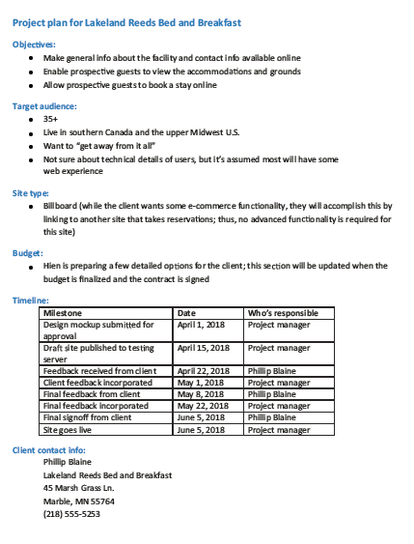
Lab 1 Test (Week 2 & 3) & Online Test 1 Practice
Question 31) The figure above shows a project plan that includes a section for the budget. In general, it is recommended that a budget be included ____.
A. if the project is coming in over budget B. if the project is more than $10,000 C. in every website design project D. if the client asks for one
Every website project should include a budget so costs, resources, and expenses can be planned and managed properly.

Slide 148
Lab 1 Test (Week 2 & 3) & Online Test 1 Practice
Question 32) Identifying the type of website is an important part of a project plan; and the figure above lists this site type as “Billboard.” Usually websites have one of a small number of main functions that do NOT include: _____.
A. online informational brochure B. site that converts HTML into XML C. site that sells products and services D. site that extracts information from databases
Websites are usually designed to share information, sell products, or display data. Converting HTML into XML is not a common main function of a website.

Slide 149
Lab 1 Test (Week 2 & 3) & Online Test 1 Practice
Question 33) You plan to do some research on the types of web browsers your users will use. Referring to the figure above, this information fits in the ____ section of the project plan.
A. Site type B. Timeline C. Client contact info D. Target Audience
Researching which web browsers users use helps understand the target audience and their technology preferences.

Slide 150
Lab 1 Test (Week 2 & 3) & Online Test 1 Practice
Question 34) The figure above shows a timeline that includes milestones, the date the project will be completed, and who is responsible for each task. Normally, you do NOT need to include ____ in the timeline.
A. milestones B. completion date C. person responsible for each task D. None of the above, all of these items should be included
A proper project timeline should include milestones, deadlines, and who is responsible for each task to keep the project organized and on schedule.

Slide 151
Lab 1 Test (Week 2 & 3) & Online Test 1 Practice
Question 35) The owner of your company said he primarily wants to know one thing: “Why do you want a website?” Referring to the figure above, the answer to this question is in the ____ section of the project plan.
A. Objectives B. Target Audience C. Site type D. Budget
The objectives section explains the main goals and reasons for creating the website, such as sharing information or attracting customers.

Slide 152
Lab 1 Test (Week 2 & 3) & Online Test 1 Practice
Question 36) Scott hires an intern to help with the project, and realizes that the new intern has uploaded all of the testing pages to the final upload location on the web server. Scott tells the intern the following: _____.
A. “Good job. That is exactly where they go.” B. “That is not a good location because all the pages are now available to the public.” C. “That is not a good location because ‘testing’ pages should never be put on a server.” D. “The pages will not appear on the server because the pages should have been downloaded, not uploaded.”
Testing pages should not be uploaded to the public website because visitors may see unfinished or incorrect content.

Slide 153
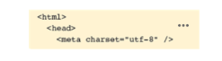
Lab 1 Test (Week 2 & 3) & Online Test 1 Practice
Question 37) In the figure above, the head element is _____.
A. a child of the html element B. the parent of the meta element C. Both A and B. D. Neither A nor B.
The <head> element is inside the <html> element, making it a child of <html>. It also contains the <meta> element, making it the parent of <meta>.

Slide 154
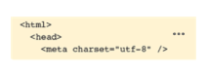
Lab 1 Test (Week 2 & 3) & Online Test 1 Practice
Question 38) In the figure above, the html element is the ____ element of the meta element.
A. child B. sibling C. cousin D. grandparent
The <html> element contains the <head> element, and the <head> element contains the <meta> element. Therefore, <html> is the grandparent of <meta>.

Slide 155
Lab 1 Test (Week 2 & 3) & Online Test 1 Practice
Question 39) In the figure above, the meta element can be referred to as a ____ element of the html element.
A. grandparent B. grandchild C. sibling D. cousin
The <meta> element is inside the <head> element, and the <head> element is inside the <html> element. This makes <meta> the grandchild of <html>.

Slide 156
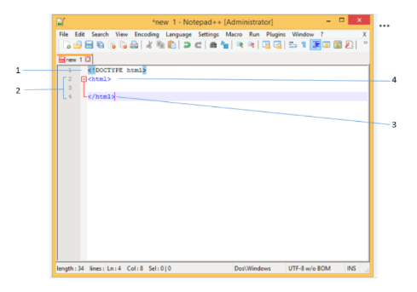
Lab 1 Test (Week 2 & 3) & Online Test 1 Practice
Question 40) In the figure above, the application “Notepad++” is a(n) _____.
A. HTML program B. word processor C. text editor D. web editor
Notepad++ is a text editor used to write and edit code such as HTML, CSS, and JavaScript files.

Slide 157
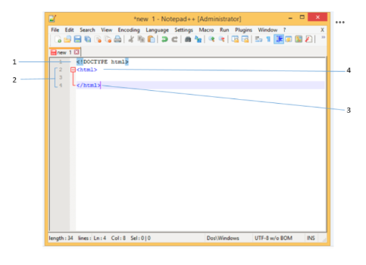
Lab 1 Test (Week 2 & 3) & Online Test 1 Practice
Question 41) In the figure above, item #1 tells the user agent that the code is written in ____.
A. XHTML B. XML C. CSS
D. HTML
Item #1 is the <!DOCTYPE html> declaration, which tells the browser that the document is written in HTML5.

Slide 158
Lab 1 Test (Week 2 & 3) & Online Test 1 Practice
Question 42) Before creating their website, Mark and Sebastian identify the location of main webpage elements using a wireframe. They leave a few areas of the website intentionally blank to help balance the design of an asymmetrical page. What are these intentionally left blank spaces called?
A. Passive white space B. Active white space C. Active dark space D. Passive dark space
Active white space is empty space intentionally added to improve balance, readability, and the overall visual design of a webpage.

Slide 159
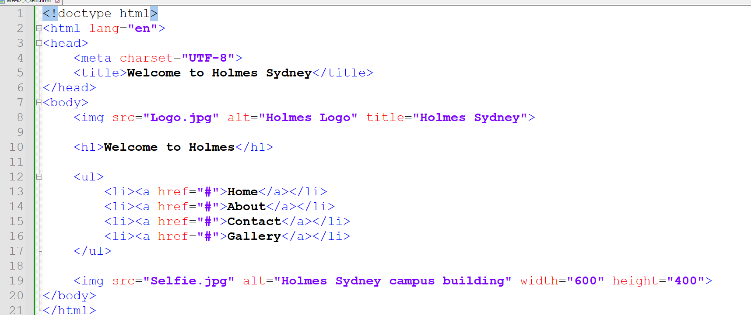
First Web Design Example - Selfi

Slide 160
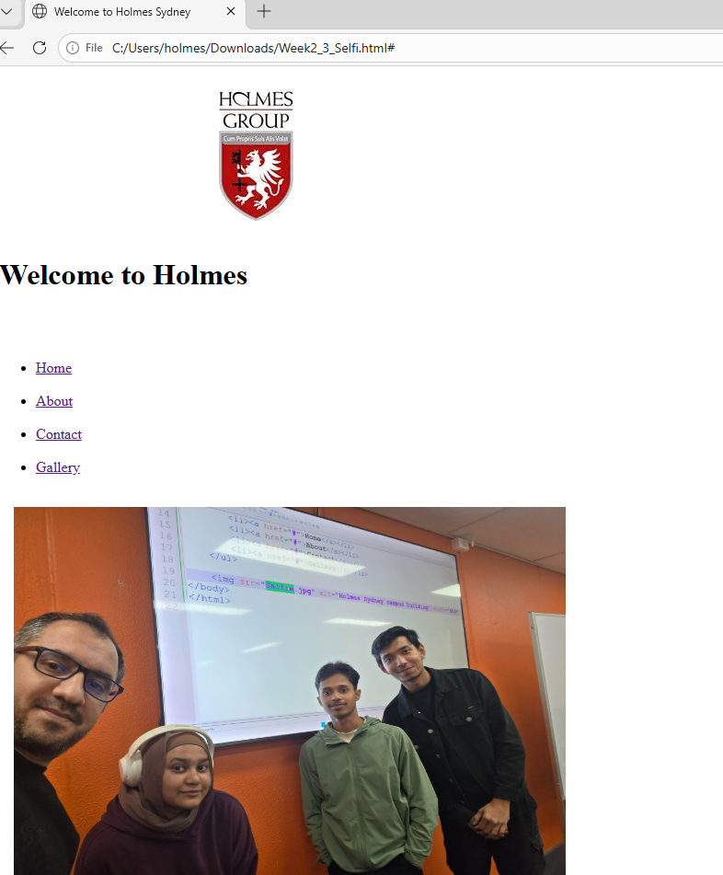
First Web Design Example - Selfie

Slide 161

Let’s Answer Your Questions
Live during class – Ask directly during sessions.
Blackboard Inbox – For structured academic queries.
Email – For formal communications or attachments.
Discussion Forum – Everyone can see and learn from your question.

Slide 162

Thank You
Happy Learning and Bright Futures Ahead!
Stay Connected: linkedin.com/in/farshid-keivanian github.com/FarshidKeivanian
Education is the most powerful weapon you can use to change the world. — Nelson Mandela

